Slide 1
7 Sins in NYC
Chuan Sun
NYC Data Science Academy
July 21, 2016

Slide 2


Slide 3







7 Sins
Burglary
Grand larceny of
motor vehicle
Felony assault
Grand larceny
Rape
Robbery
Murder

Slide 4
Dataset
The NYPD 7 Major Felony Incidents dataset
~1.1 million incidents, 22 variables, 194 MB size
Extracted all incidents in the last 10 years (2006-2015)

Slide 5
Questions
Is NYC becoming safer over the last 10 years?
Which months of a year are safer?
Which days of a week are safer?
Which hours of a day are safer?

Slide 6
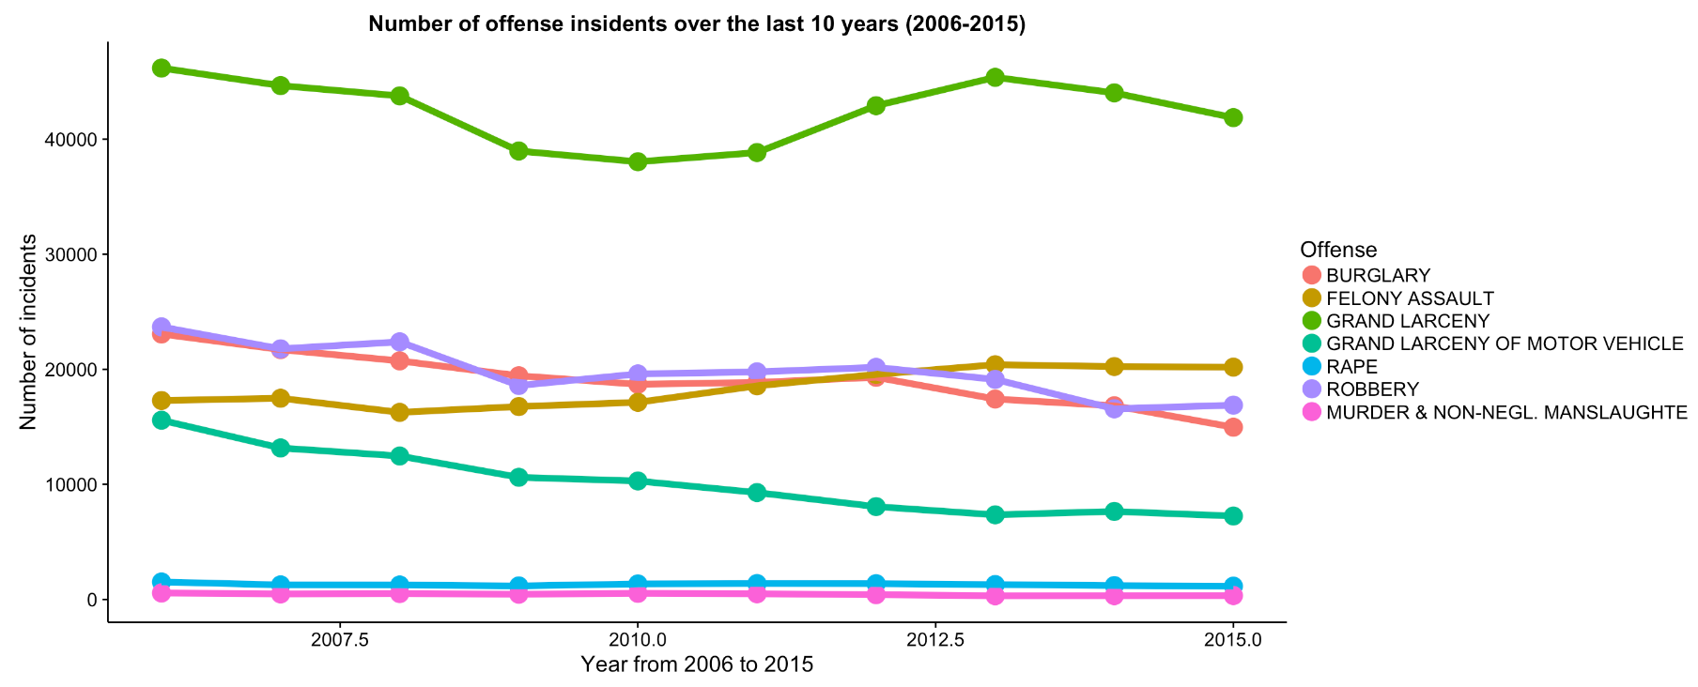
Trend in 10 years

Slide 7
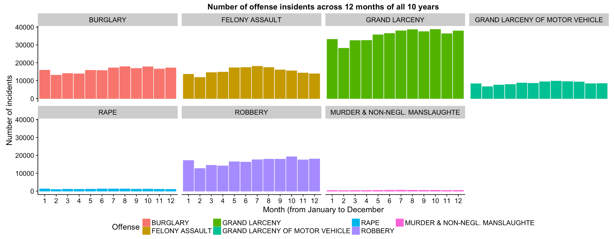
Incidents by month

Slide 8
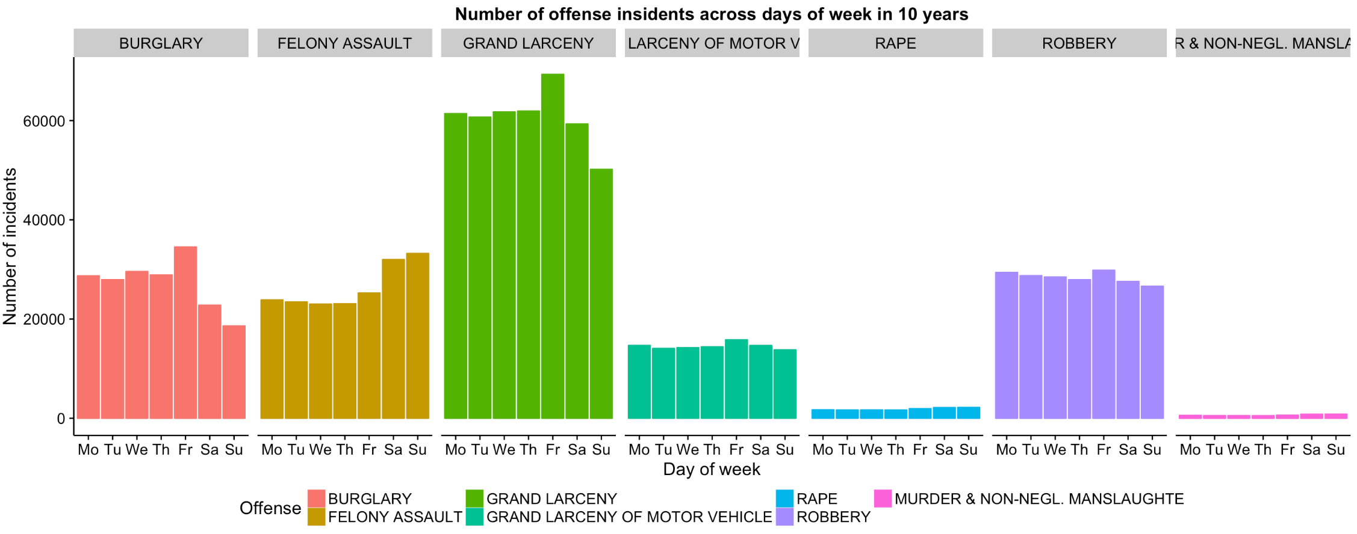
Incidents by day of week

Slide 9
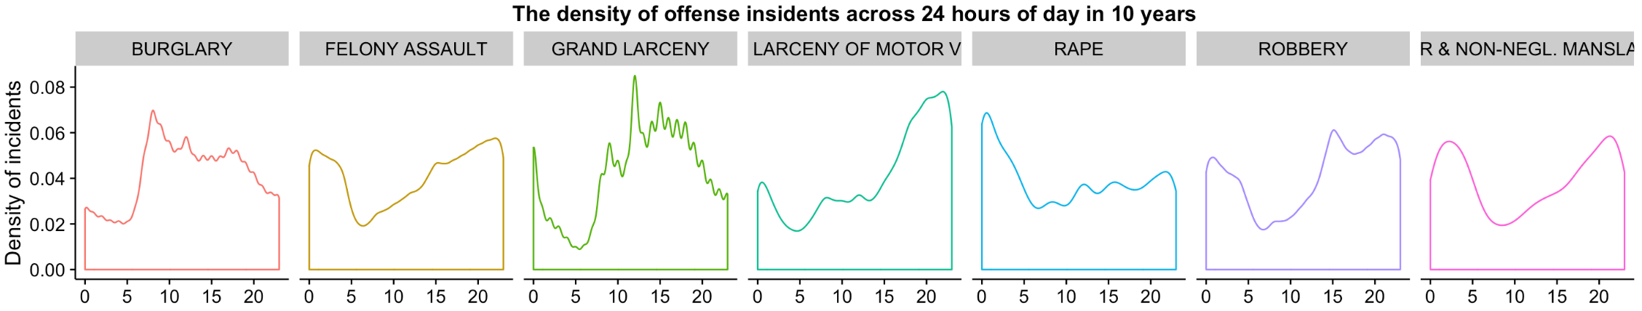
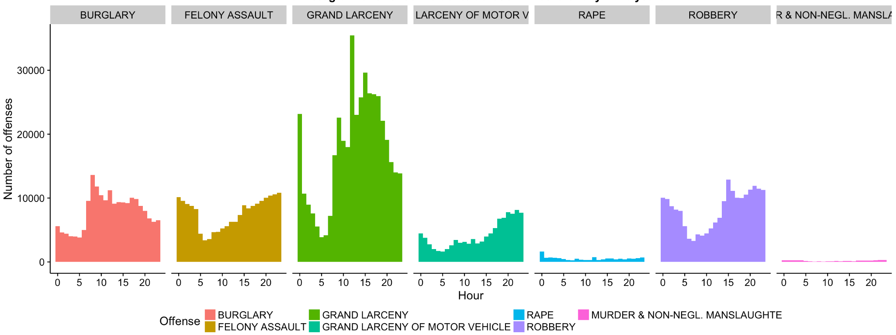
Incidents by hour
ff

Slide 10
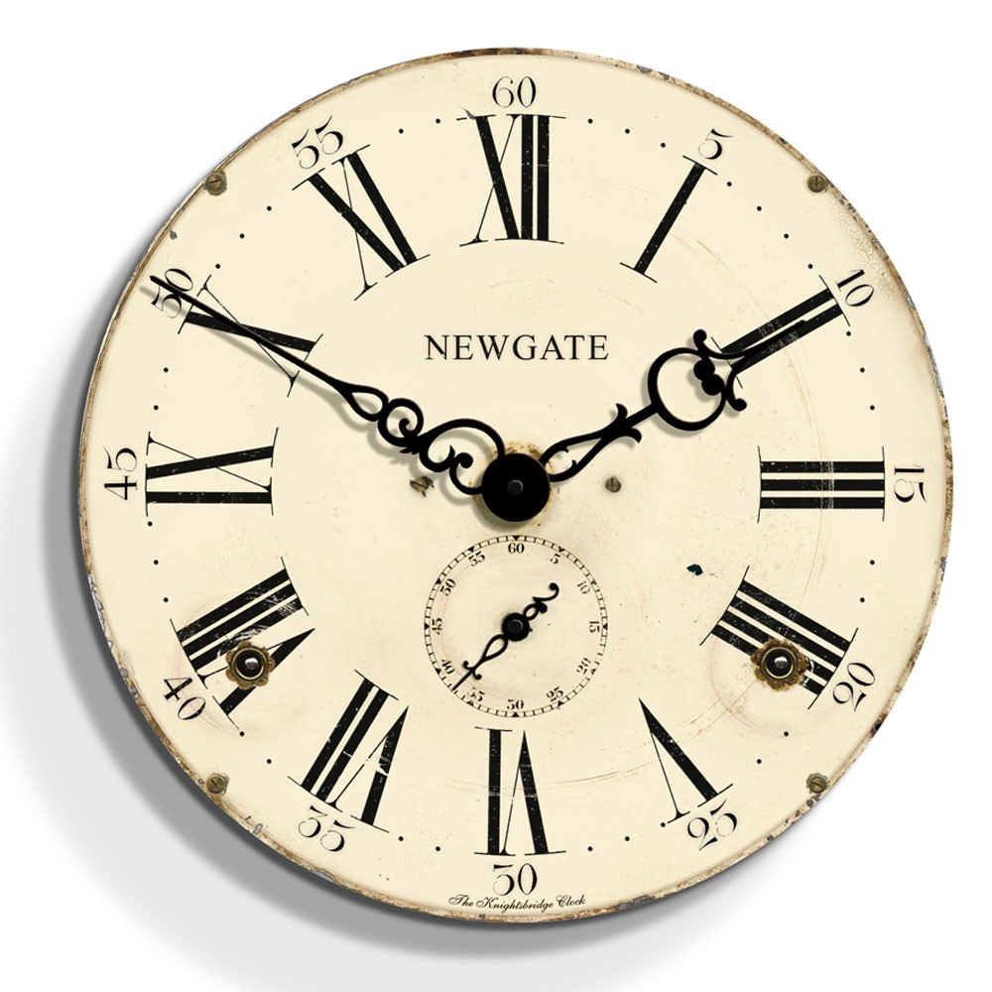
Middle night: 11pm-3am
Afternoon: 1pm-3pm
Morning: 7am-10am
Evening: 7pm-10pm

Slide 11

5am is perhaps the only safe hour!

Slide 12
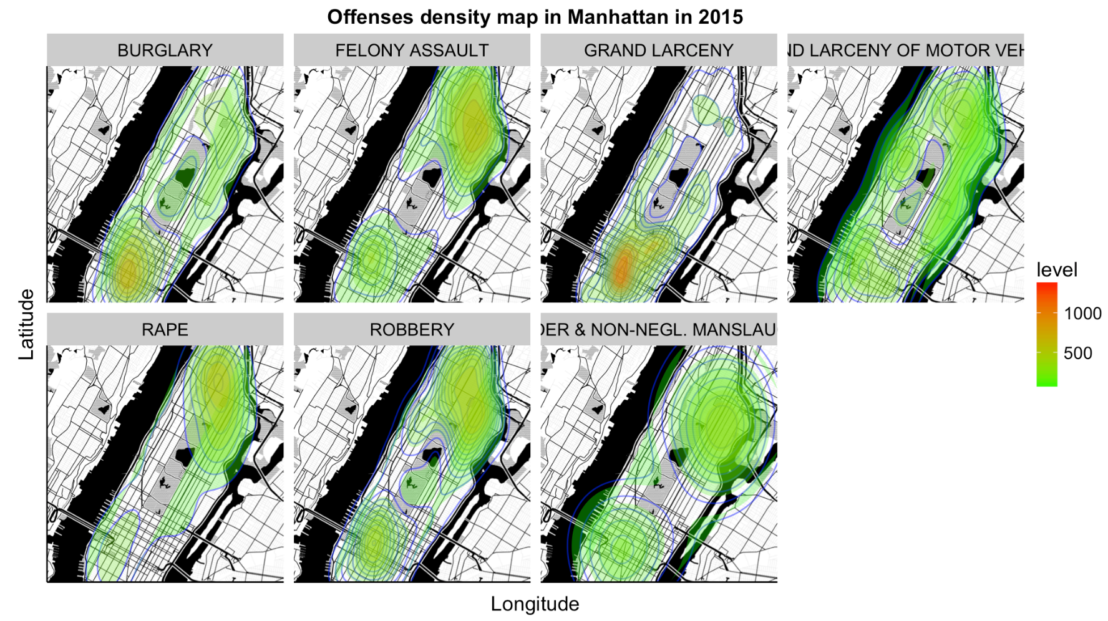
Offenses density map of Manhattan in 2015

Slide 13
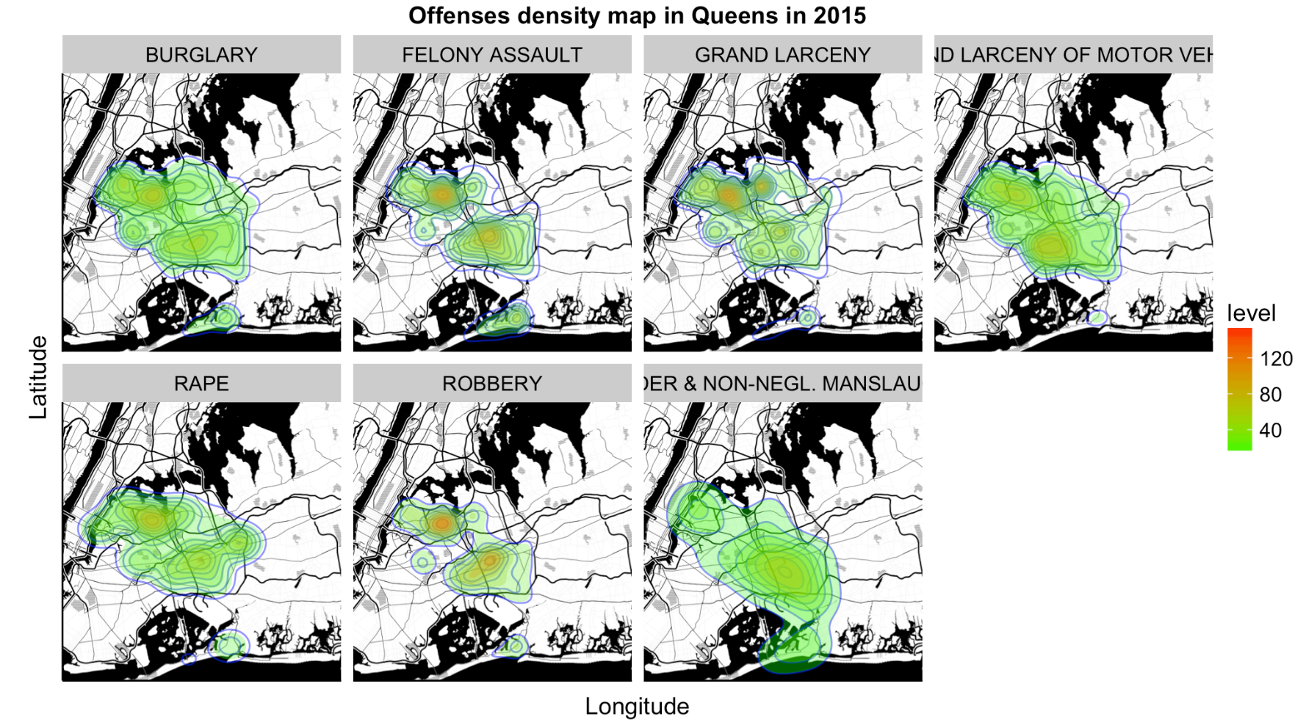
Offenses density map of Queens in 2015

Slide 14
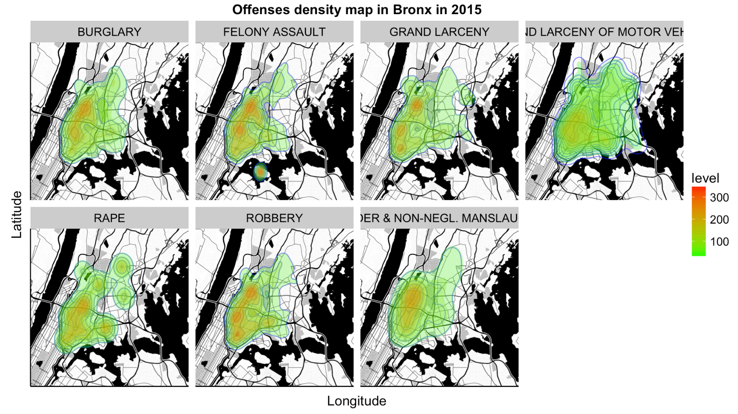
Offenses density map of Bronx in 2015

Slide 15
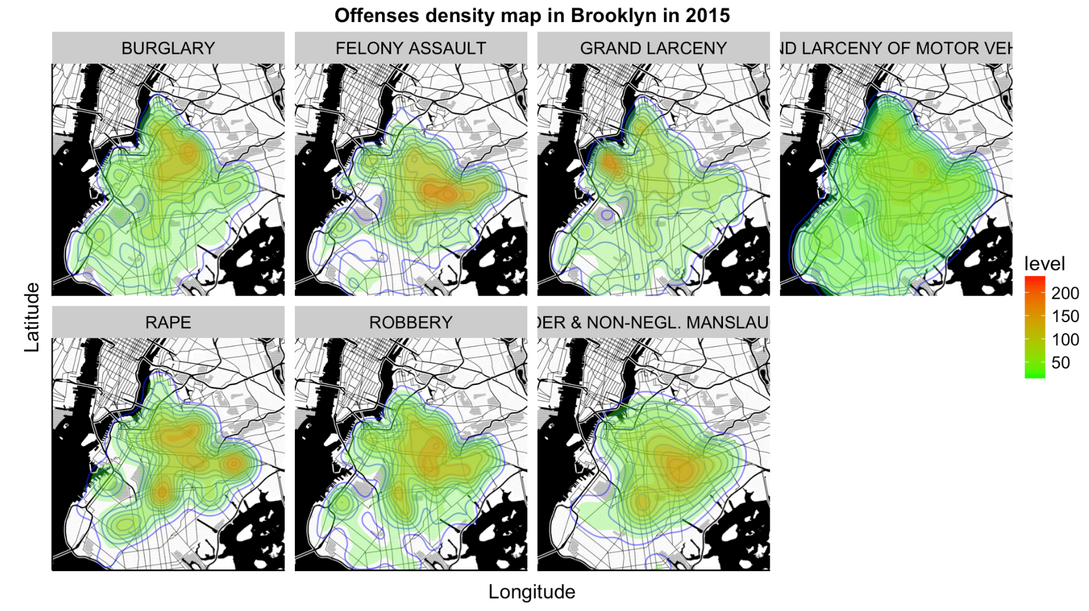
Offenses density map of Brooklyn in 2015

Slide 16
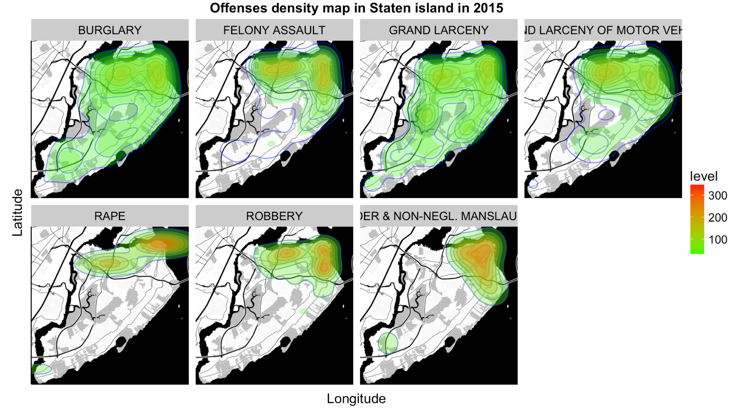
Offenses density map of Staten Island in 2015

Slide 17
Answer
Is NYC becoming safer? Yes!
Which months of a year are safer? February.
Which days of a week are safer? Weekend.
Which hours of a day are safer? 5am.

Slide 18
Thanks!

